Slide 2
Integrating Blazor with existing .NET web apps
Ed Charbeneau
Principal Developer Advocate at Progress Software

Slide 3
ASP.NET Core UI, the choice is yours
ASP.NET Core
Razor Views (MVC)
Razor Pages
Razor Components
Headless (Web API + JavaScript)

Slide 4
ASP.NET Core UI, the choice is yours
Razor Views (MVC)
Razor Pages
Razor Components
Headless (Web API + JavaScript)

Slide 5

ASP.NET Core UI, the choice is yours
Razor Views (MVC)
Razor Pages
Razor Components
Headless (Web API + JavaScript)

Slide 6
ASP.NET Core UI, the choice is yours
Razor Views (MVC)
Razor Pages
Razor Components
Headless (Web API + JavaScript)

Slide 7
ASP.NET Core UI, the choice is yours
Razor Views (MVC)
Razor Pages
Razor Components
Headless (Web API + JavaScript)

Slide 8

ASP.NET Core is Modular
01: var builder = WebApplication.CreateBuilder(args);
02: // Add Web API controllers
03: builder.Services.AddControllers();
04: // Add Razor Views
05: builder.Services.AddMvc();
06: var app = builder.Build();
07: // Configure Routing
08: app.MapControllers();

Slide 9


ASP.NET Core is Modular
01: var builder = WebApplication.CreateBuilder(args);
02: // Add Web API controllers
03: builder.Services.AddControllers();
04: // Add Razor Views
05: builder.Services.AddMvc();
06: var app = builder.Build();
07: // Configure Routing
08: app.MapControllers();
HTTP:

Slide 10

ASP.NET Core is Modular
01: var builder = WebApplication.CreateBuilder(args);
02: // Add Web API controllers
03: builder.Services.AddControllers();
04: // Add Razor Views
05: builder.Services.AddMvc();
06: var app = builder.Build();
07: // Configure Routing
08: app.MapControllers();
cshtml
HTTP:

Slide 11
ASP.NET Core is Modular
01: var builder = WebApplication.CreateBuilder(args);
02: // Add Web API controllers
03: builder.Services.AddControllers();
04: // Add Razor Views
05: builder.Services.AddMvc();
06: var app = builder.Build();
07: // Configure Routing
08: app.MapControllers();
MVC App

Slide 12


ASP.NET Core is Modular
01: var builder = WebApplication.CreateBuilder(args);
02: // Add Web API controllers
03: builder.Services.AddControllers();
04: // Add Razor Views
05: builder.Services.AddMvc();
06: var app = builder.Build();
07: // Configure Routing
08: app.MapControllers();
https://myapp.net/my-resource-location

Slide 13

ASP.NET Core UI, the choice is yours
Razor Views (MVC)
Razor Pages
cshtml
cshtml
MapControllers
MapBlazorHub
Razor Components
Headless (Web API + JavaScript)
MapRazorComponents
razor
html

Slide 14

Modernization with Razor Components
Full-stack .NET (C#)
Little to no JavaScript
Enhanced Productivity
Component architecture
Data Binding
Intuitive Templating
Rendering Options
Static Server (HTML)
Server Interactive (SignalR)
Client Interactive (WASM)

Slide 15
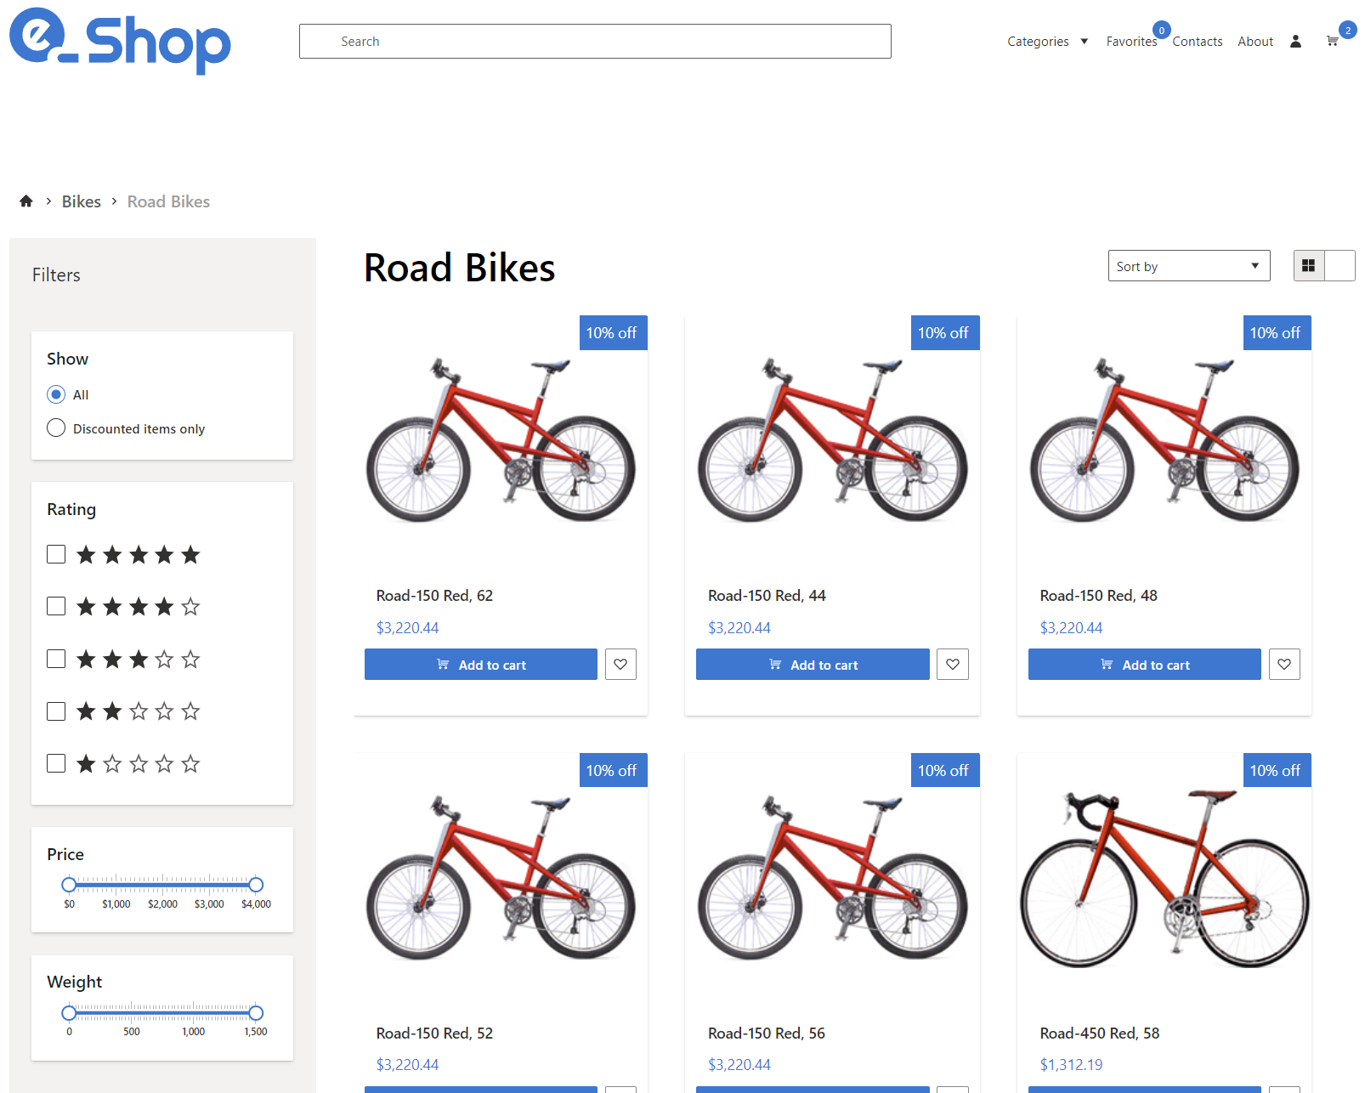
Demo
Integrating Blazor with an existing ASP.NET Core MVC App

Slide 16


Resources
EdCharbeneau.com EdCharbeneau.com/dotnet-8
Telerik UI for Core & Blazor .NET 8 Day Zero Support! prgress.co/3QLhK2C

Slide 17
Download .NET 8
https://aka.ms/get-dotnet-8

